Slide 1



PROJECT MUNICIPAL (M)
MITB Consultancy Pte Ltd
Meet Our Consultants: Chan En Ying Grace​, Business Analyst Charu Malik​, Environmental Modelling Analyst Chaisiri Toomthong, ​Change Management Analyst
Luo Haoran​, Project Success Consultant Priyanka Sharma​, Vendor Sourcing Consultant Zhou Ying Ying​, Project Manager
Song Ying​, Solutions Architect

Slide 2
OUR CONSULTANCY EXPERTISE
1. Project Characteristics
2. Motivations behind Project M
Chan En Ying Grace​, Business Analyst
3. Considerations: The IT interaction Model
4. Timeline of Events
5. Managing Multiple Stakeholders
Charu Malik​, Environmental Modelling Analyst
6. Change Management Strategy
Luo Haoran​, Change Management Analyst

Slide 3
OUR CONSULTANCY EXPERTISE
7. Definition of Project Success
Chaisiri Toomthong, ​Project Success Consultant
8. Vendor Procurement & Challenges
Priyanka Sharma​, Vendor Sourcing Consultant
9. Application of PM Knowledge Areas
Zhou Ying Ying​, Project Manager
10. Recommendations & Conclusion
Song Ying​, Solutions Architect

Slide 4
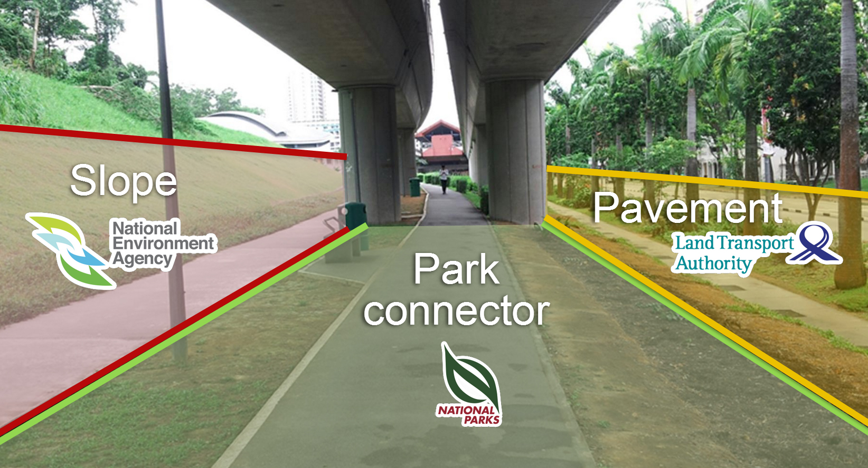
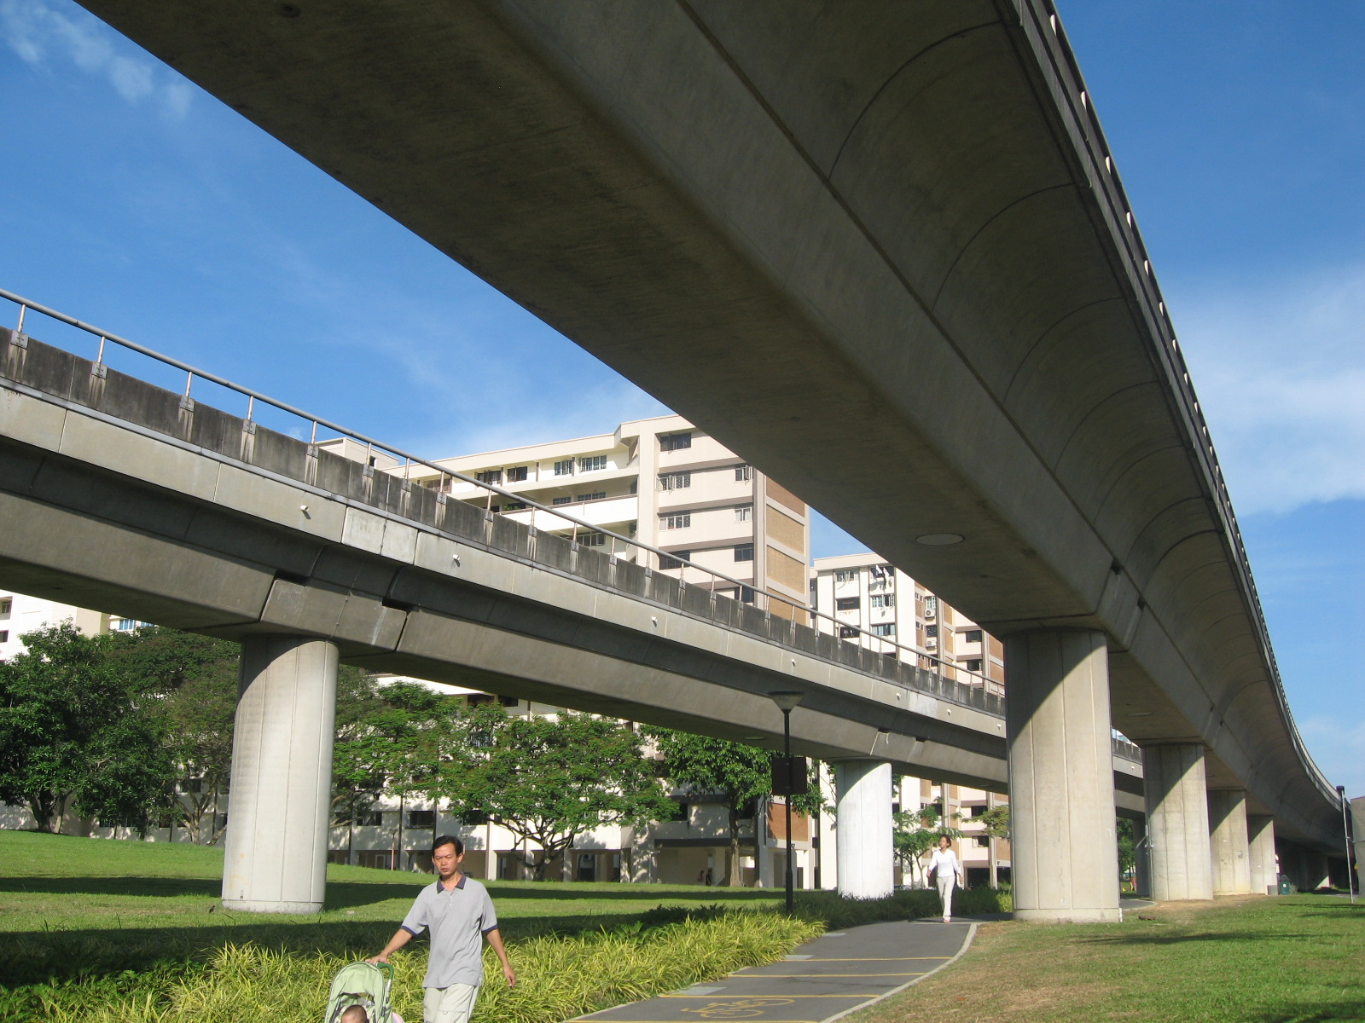
If you see a fishball stick here… ( ) which agency should you call to complain?
Menti Time!
www.menti.com
Code: 11-16-81
Vote For One
National Environment Agency
Land Transport Authority
National Parks Board

Slide 5
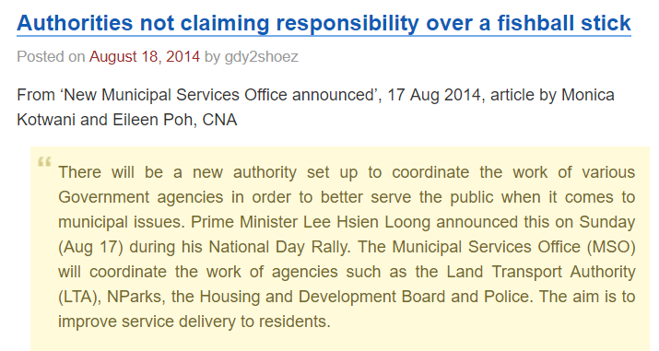
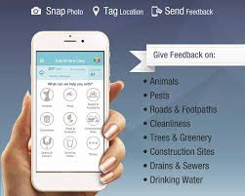

2014

Slide 6

AUTHORITIES NOT CLAIMING RESPONSIBILITY? REALLY?
Inter-agency approach and joint-solutioning efforts the way forward, but systems did not provide for such collaborations

Slide 7
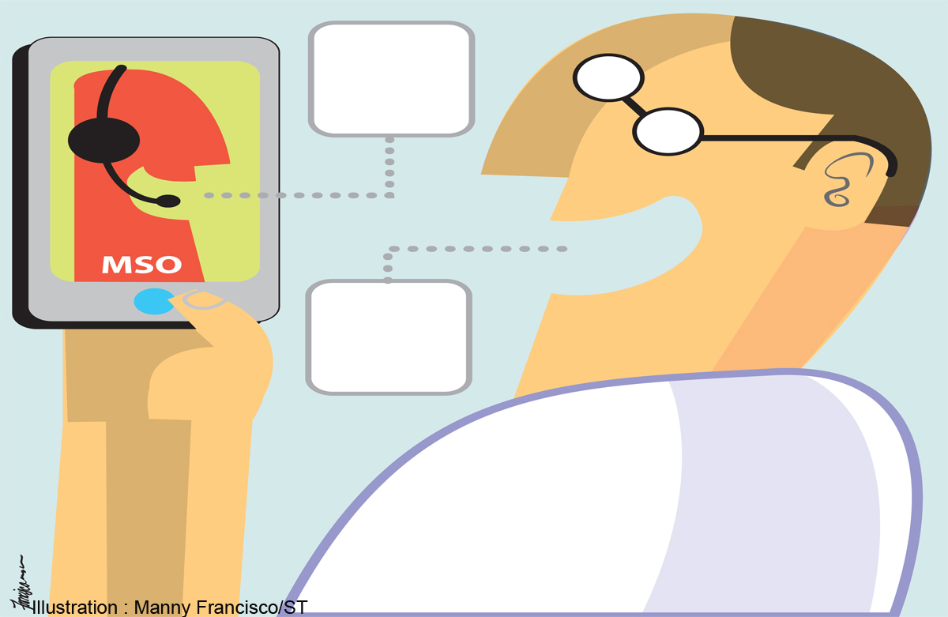


Now… Too Many Agencies Having Their Own Systems!
2017
Project M comes to the rescue, in Sep 2017
Strives to introduce a ‘whole-of-government’ (WOG) case management system
1. Allows efficient channelling of feedback to relevant government agencies (C2G)
2. Provide last mile delivery to residents (G2C)

Slide 8
PROJECT CHARACTERISTICS
Presented By Chan En Ying Grace​, Business Analyst

Slide 9
What Is Project M?
Project Owner: People’s Association (PA), a government statutory board under the MCCY
Aim: To empower public officers to adopt a more resident-centric, WOG approach in feedback management and solutioning efforts
Deliverable: A one-stop, integrated system that provides a 360-degree view of municipal feedback
This included a mobile device to enable public officers to capture municipal feedback on-the-go and deploy cases to agencies seamlessly.
To allow officers to also track case status, as well as understand past records and steps that the agencies have taken.
For better service delivery to the citizens
Notes:
This included a mobile device to enable public officers to capture municipal feedback on-the-go and deploy cases to agencies seamlessly.
Track case status, as well as understand past records and steps that the agencies have taken. To provide proper loop closure with the resident.

Slide 10
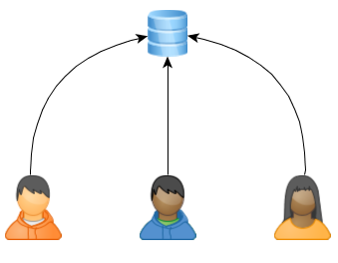




Goals of Project M
Hardware
Heartware
Interfacing with other government agencies’ systems
Feedback Capture by public officer; understand needs
Secured IT environment on-the-go & support large user base across 89 BUs
Improve last mile delivery to citizen; update case status
Your Feedback Matters
Notes:
Efficient data capturing, compilation, extraction and processing of feedback records collected by public officers
Provide analysis of feedback provider demographics, useful for planning
Support the large user base from 89 business units; each situated at the town level
Allow interfacing with case management systems across other government agencies

Slide 11
What System M Comprises Of
2 Application Components
Web-Based Client-End Application Component
(Mobile Device)
Web-Based Backend Application Component
(Intranet)
3 Key Modules
Feedback Management
Household Management
Interfaces (e.g. with MSO One Service App)
Notes:
The System consists of two application components: Web-Based Client-End Application Component (Mobile Device) and Web-Based Backend Application Component (Intranet). It consists of three key modules – Feedback Management, Household Management, and Interfaces.

Slide 12
Project Characteristics
1. Systems Integration
Integration: Links PA’s internal systems, external systems (from other government agencies) & new systems
Vendor: Outsourced to SM, an SI vendor that specialises in urban planning.
Hybrid Codes: The solution, developed by SM, consisted of a hybrid of adapted code (from a previous system that had similar functionalities) and new programs to serve PA’s purposes.
Notes:
The System consists of two application components: Web-Based Client-End Application Component (Mobile Device) and Web-Based Backend Application Component (Intranet). It consists of three key modules – Feedback Management, Household Management, and Interfaces.

Slide 13
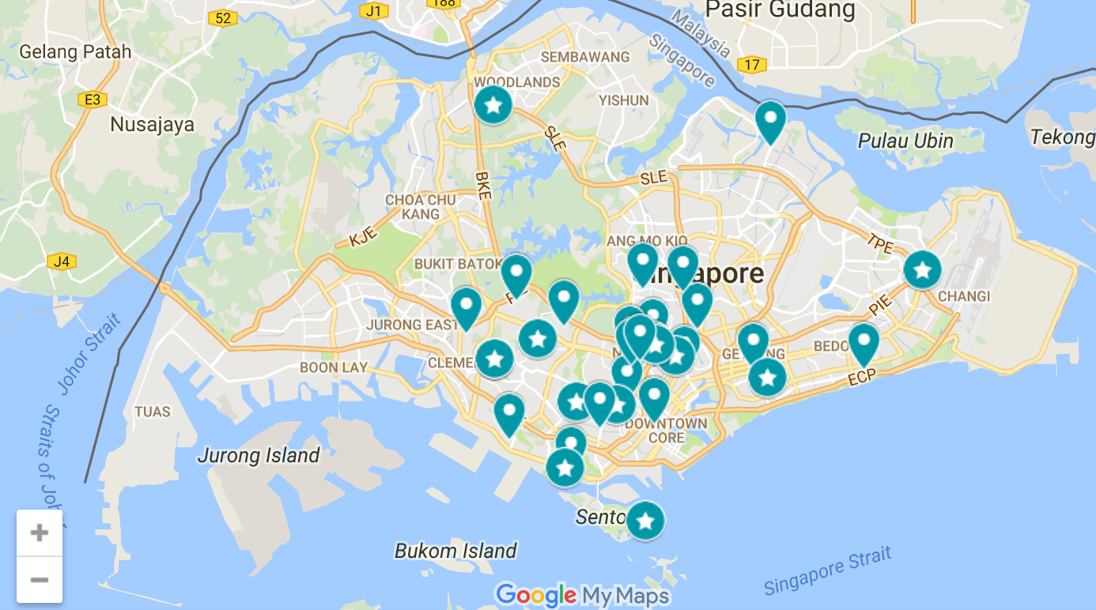
Project Characteristics
2. Government Project, Nationwide Effort
Government-led project involving all government agencies
Involves 89 town-level business units across Singapore
In short, most agencies and public officers in direct contact with residents would be a beneficiary of this system, either directly or less directly.
Users: Public Officers
Beneficiaries: Citizens
Notes:
Project M is a government-led project that cut across all government agencies and every municipal business unit* in each town across Singapore. Led and sponsored by the People’s Association, a statutory board that serves as the bridge between the People and Government, the System rolled out was a G2C (Government-to-Citizen) initiative that allowed public officers to capture feedback cases raised by residents and channel them to the Government. Vice versa, actions taken by agencies to close the case were also conveyed via this system to close the loop with the resident.
The M System consists of an (1) intranet portion interfaced with all government agencies, as well as a (2) web-based deliverable, the M mobile device, used by public officers of the 89 business units (one per town). In short, most agencies and public officers in direct contact with residents would be a beneficiary of this system, either directly or less directly.

Slide 14
MOTIVATIONS BEHIND PROJECT M: THE NEED FOR ONE-SERVICE SYSTEM (not…one-agency system)

Slide 15

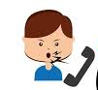
Pain Point 1: Manual Processing; Overdue Cases
80% of municipal cases were recorded by public officers using pen and paper
Double & onerous entry, with the greatest pain point being “illegible handwriting due to the pressure of time”
Excel-Based: Had to manually update the cases as and when they receive a reply from other agencies.
As such, they were error prone;
About one quarter of these cases were overdue and did not meet the service response time of 3 days
Some “lost in transmission” as there were too many cases to track with no alert system
Resulting in poor service standards to residents
As the frontline, public-facing service provider for government agencies, improving Service Delivery was a priority for the organisation.
Notes:
Prior to Project M, 80% of municipal cases were recorded by public officers using pen and paper. After collection, staff had to type it up into their email client to assign the case to the relevant agencies. This resulted in not only double but also onerous entry, with the greatest pain point quoted by public officers as “illegible handwriting due to the pressure of time on the ground” as they had to balance between retaining the human touch during resident engagement and accurate data capture.
Moreover, the cases were typically maintained in excel for manual tracking. On a daily basis, this could approximate to up to 50 cases per day, per business unit to keep track of. Staff also had to manually update the cases as and when they receive a reply from other agencies. These cases were manually handled and closed. As such, they were error prone; about one quarter of these cases were overdue and did not meet the service response time of 3 days, and some “lost in transmission” as there were too many cases to track with no alert system, resulting in poor service standards. As the frontline, public-facing service provider for government agencies, this was a priority for the organisation.

Slide 16

Pain Point 2: No Integrated Platform; Duplicated Processes
Case solutioning process involved many agencies, where each had its own rules with lack of coordination between one another.
Complicated cases with no clear “owner” or those requiring joint solutioning efforts can be forwarded to up to five agencies, some taking weeks to decide whose agency this case fell under.
This translated into higher transaction cost and poor service standards, where residents had to wait for the feedback to be resolved and be contacted by agency after agency
Agencies’ Systems did not talk; lacked a Whole-of-Government approach.
Notes:
Secondly, the case solutioning process involved many agencies, where each had its own rules with lack of coordination between one another. Their systems did not talk and lacked a Whole-of-Government approach. Complicated cases with no clear “owner” or those requiring joint solutioning efforts can be forwarded to up to five agencies, some taking weeks to decide whose agency this case fell under. This translated into higher transaction cost and poor service standards, where residents had to wait for the feedback to be resolved and be contacted by agency after agency.

Slide 17

Pain Point 3: Multiple Service Nodes; No Common Frontline
The resident would be faced with different public officers
The officer collecting the case, is likely to be different from the officer processing the case, which is also likely to be different from the last officer contacting the resident to close the loop – 1 resident facing at least 3 officers per case
There lacked a single point of contact, and frustrated residents had to be redirected from agency to agency, officer to officer.
Need for Common Front Line – Abide by “No Wrong Door Policy”
Notes:
Thirdly, there was no common frontline. The resident would be faced with different public officers, and the officer collecting the case, is likely to be different from the officer processing the case, which is also likely to be different from the last officer contacting the resident to close the loop. There lacked a single point of contact, and frustrated residents had to be redirected from agency to agency, officer to officer.

Slide 18

Pain Point 4: System Security
Each business unit had its own way of data management and this placed data at a greater risk of exposure
With the introduction of Internet Separation for all government devices, it called for a more secure hosting of data, than relying on excel spreadsheet or secured cloud storage.
The availability of Government Data Centre (GDC) provided a viable option for secure hosting that the organisation needed to turn to.
Need for greater data and system security
Notes:
Lastly, each business unit had its own way of data management and this placed data at a greater risk of exposure. With the introduction of Internet Separation for all government devices, it called for a more secure hosting of data, than relying on excel spreadsheet or secured cloud storage. The availability of Government Data Centre (GDC) provided a viable option for secure hosting that the organisation needed to turn to.

Slide 19
CONSIDERATIONS THAT PUSHED FOR PROJECT DEVELOPMENT
Why so urgent?
Used proactively & reactively throughout Project M
Presented By Charu Malik​, Environmental Modelling Analyst

Slide 20
Timeline of Events
“Change Management Strategy” Phased, gradual transition to allow users to better cope with process change +
Allows project team to finetune requirements between phases.
“Be Selective, Pick Right Ambassadors” Pilot Towns Selected were IT Savvy with greater buy-in
2013
Dec 2015
May 2016
Sep 2016
Jan 2017
Sep 2017
Dec 2018
Jun
2019
Ideation
Management
Buy-In
Proof Of Concept
First Limited Invitation To Tender (ITT)
Second ITT
Revised Requirements
SM Awarded
Final Requirement (Phase 1) Confirmed
Phase 1 Rolled Out
26
Business Units
Phase 2
30
Business Units
Phase 3
33
Business Units

Slide 21
External Environment Factors
1. Economy
PM Lee’s National Day Rally Message to ‘Go Digital’.
Digital transformation at every level of the government enabled speedy development of Project M; push for "buy-in".
2. Competitive Structure
Singapore looking towards China as its main digital competitor.
Competition between various government agencies to ‘Go Digital’.
3. State of Technology
The Block Chart System, a proprietary system previously developed by SM for another government agency only required minor modifications.

Slide 22
Organisational Environment Factors
1. IT Infrastructure Already In Place
Ability to leverage on SingPass 2 Factor Authentication as a security access feature.
2. Organisational Culture
[Across Agencies] Move towards ‘Whole-of-Government’ collaborative, tripartite approach.
[Internally] PA’s extensive grassroots network brought together multiple stakeholders.
3. PA’s Strategy: Leverage on Mobilisers
Project made known to Grassroots Advisers as most powerful stakeholders who endorsed and evangelized the project within their own business units.

Slide 23
MANAGING STAKEHOLDERS
Who Is My Important Guy?
"Knowing the Key Guy is Important"

Slide 24

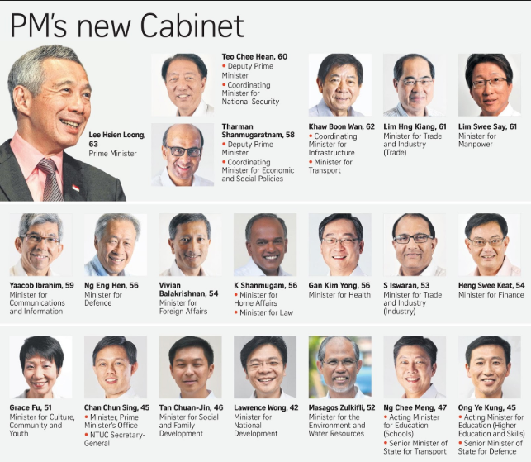

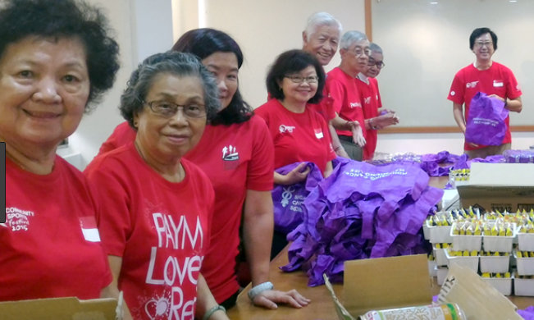


Government-Affiliated Stakeholders
MENTI CODE: 11-16-81
Government Agencies
Grassroots Advisers (MP’s)
PA Staff
50,000 Grassroots
Volunteers
PA Senior Management
Project Owner/ Sponsor

Slide 25
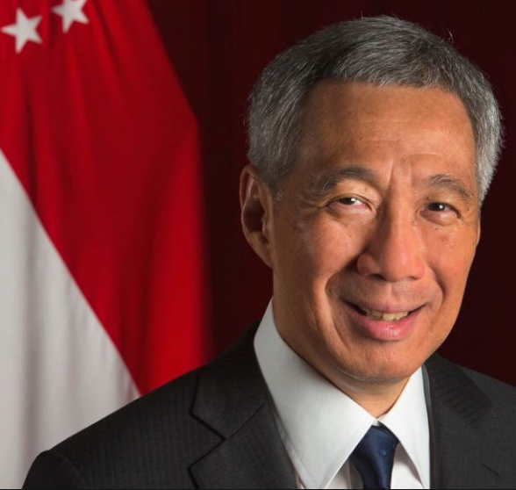
Cabinet Minister
Powerful Stakeholders
Project Champion
Meetings at town level to obtain buy-in from grassroots advisors
Evangelized Project M to grassroots advisors ->
Advisors evangelized to volunteers and staff

Slide 26
No ‘One-size-fits-all’ Solution
M system implemented to standardize processes, but the way this technology was adopted and applied to their work processes varied from unit to unit, town to town.
System could be very useful for one town and not so useful for another due to different work processes.
Not possible to accommodate all user requirements.
Clear communication key to ensure all towns were still on board.

Slide 27
PROJECT COMPLEXITY & CHANGE MANAGEMENT
6-Pronged Approach
Presented by Luo Hanran, Change Management Analyst
Notes:
I’m sure after Grace and Charu’s introduction, we all have a brief but clear understanding about this government project, what are the reasons that we need to launch it, who will be benefitted from it and what are the characteristics of it.
Now I’ll walk you through the complexity of the project and change mgt plan, which will help us dig deeper into the project nature.

Slide 28
Project Complexity – Medium to High
Project Type: Systems Integration
Geographic Spread: Nationwide, cutting across ALL govt agencies
Scale: ALL public officers (>100,000++)
Nature: Government
Components & Modules:
▷Web-Based Client-End Application Component
▷Web-Based Backend Application Component
▷3 key modules: Feedback Management; Household Management; Interfaces
Notes:
This project is a system integration project.
It involves all 89 towns in Singapore so it’s nationwide. Also it impacts the working process of all government agencies, including more than 100,000 public officers.
Because the system is serving government agencies, the nature of the project is a government project.
As for the function modules and components, we have a client-end application component, which basically is mobile device, and an intranet backend application component. And also we have feedback management, household management and an interface/API as key modules.

Slide 29
Change Management Strategy
1. User Training
The training content was jointly curated by PA’s training arm, National Community Leadership Institute (NACLI) that specialised in community leadership, as well as the vendor, SM.
Important as technical knowledge was contextualised to public officers’ work context when it was delivered.
The content was also jointly delivered, which was critical because the public officers felt comfortable enough to voice their concerns with the presence of internal staff, whenever there was resistance to work process change.
Soft skills training: retain human touch with residents
Notes:
1st is user training.
PA’s training arm and our vendor SM jointly curated and delivered the training content. In that way, we could make sure that all of the technical knowledge had been well delivered to the system users, and make sure that the technical knowledge had been contextualized and tailored to fit the working environment of each officers.
Jointly-delivery could encourage the public officers to voice their concerns with internal staff present in the training session.
Also our training team used the method of role-play to learn how to evaluate the cases and maintain human touch with residents.

Slide 30
Change Management Strategy
2. Customised Process Change Mapping
Secondly, user training was customised at the town level, for public officers and grassroots volunteers.
Trainers sat down together with the stakeholders in each of the 89 business units and planned through the process changes, with them.
The ‘hand-holding’ approach smoothened the transition for the stakeholders who were going to embrace the process change.
Notes:
2nd is customized process change mapping. Trainers would sit down with stakeholders in each of 89 business units, and plan through the process changes to make sure that the system shifting process would be done in a customized way.
This approach is called hand-holding approach, which smoothened the whole transition process.

Slide 31
Change Management Strategy
3. Close Management Support
Project team as well as senior management joined every staff and volunteer training, as well as during the actual implementation on the ground.
Any teething problem – be it technical issue and a matter of mindset shift to embrace change - was quickly addressed by the team (i.e. vendor, project team and the senior management).
Notes:
3rd is the strong and close support from management. Project team and senior management joined every training session for volunteers and staff, and also they were engaged in the actual implementation.
If there were teething problems like technical issue or the mindset of system shifting was not ready, management, project team or our vendor would quickly address and solved the problems.

Slide 32
Change Management Strategy
4. Empathetic 24Hour Helpdesk Support
Moreover, the 24hour helpdesk by the vendor team also comprised of the same trainers who conducted the training.
Users felt that the helpdesk was able to empathize and address queries in an implementation-centric than overly technical manner.
5. Open feedback channel & clear communication of rationale to ground officers
Not all user requirements could be implemented. This could leave some public officers “disengaged” and getting them to harmonise their processes required some “give and take”.
Notes:
4th is 24-hour helpdesk support. Those trainers who conducted training session or implementation work would be in the helpdesk team.
In this way, users could ask help at any time.
And also users would feel that helpdesk was able to empathise and address the problems more specifically and implementation-centrically, but not just in a general technical way.

Slide 33
Change Management Strategy
The decision was typically made at the Project Working Committee level, that consisted of both officers from various business units as well as senior management.
First, an open platform (email inbox & hotline) was created where officers could submit their requirements.
Next, it was a SOP to “close the loop” with the officer to whether the requirement was implemented, and if not, an explanation was also given.
This consensual based agreement made it easier for their fellow colleagues to understand why their requirement could not be taken for implementation

Slide 34
Change Management Strategy
6. Be Conservative & Start Small
Also, each town was encouraged to “start small” by only sending selected staff for training so that the roll-out was done at a phased level, even within each business unit.
That meant that, “expert users” were nominated and these users would first learn the system and pilot them within their own precincts within the town, and when they were confident and familiar enough, the expert users could then train the rest of the officers.
Notes:
Last but not lease is that we start small. Only selected officers would be educated and trained at the beginning of the training. In that way, the roll-out would be done in a phased level.
Later those expert users would pilot what they learned within their own town, and started to train the rest of the officers when they were confident and familiar with the system enough.

Slide 35
DEFINING & EVALUATING PROJECT SUCCESS
No. 1 - Know What Your
Project Sponsor Wants.
Presented By Chaisiri Toomthong​, Project Success Consultant
Notes:
Explain the definition of "project success" here
As the consultant, we need to fully understand the expectations from our project sponsors.

Slide 36
Definition of Project Success
Balancing the Triple Constraint Based on Sponsor's Needs:
Scope >> Cost & Time
Complete Stakeholder Buy-in
Clear & Aligned Project Objectives
Experienced Project Manager
Notes:
There are four factors brought up by our sponsors.

Slide 37
1. Balancing the Triple Constraint
Scope:
Highest rated by Project Sponsor
Why:
User requirements are important since each biz unit has autonomy to control working process. I.e. could choose not to or delay the adoption
Each town operated independently from one another. What’s useful for 1 town may not be useful for another.
How:
Project Champion who went across towns to evangelise Project M, the project team needed to live up to the expectations of the grassroots advisers.
Notes:
The first factor is the trade-off among three constraints: scope, time and cost.
Among triple constraints, scope has been rated highest by our project sponsor.
There are two reasons. Because each business unit/town has their own autonomy to decide the working process, it has the right to say no or delay the deliverable adoption. And each business unit/town worked independently, a requirement benifiting one town could be no use for another town.
How could we meet the scope requirement?
Our project champion worked across towns to evangelise the project, which required project team to meet the expectations from grassroots advisers, most of whom are MPs.

Slide 38
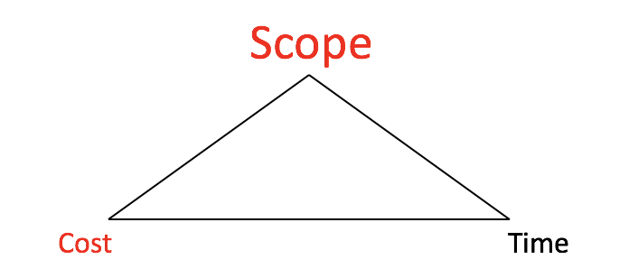

1. Balancing the Triple Constraint(Contd.)
Time:
Could be changed slightly with Scope improvements.
Cost:
No cost leeway for deviation, as guided by government procurement guidelines.
But high budget was set, so not an issue
Eventual Outcome:
Scope Met
Cost Met
Time Not Met (2 Months Delay)
Overall, Project Sponsor happy! ☺
Yes, project success.
Notes:
As for time, because the senior management/ project sponsor has accommodations for timeline change if the scope improvements has been done.
In terms of cost, there was no leeway for cost deviation because government projects have strict procurement guidelines.
Bu in fact the budget was set high, so there was no issue during the first phase.
As a result, scope and cost requirements were met, but the roll-out for the 1st phase was delayed for 2 months. Our project sponsor was satisfied with the achievement and we could call our 1st phase project a success.

Slide 39
2. Stakeholder Buy-in
Each town (biz unit) governed itself and could refuse the project implementation.
Nature of organization’s processes were “ground-up” as they were run by volunteers
The organization (PA) has no control in dictating officers’ work process.
Secret Formula: The “How”
Project Champion evangelized from town-to-town.
As a powerful cabinet minister, he was able to obtain buy-in from all advisers, who then in turn evangelized to the staff and volunteers (cascading effect)
For agency buy-in, this was not an issue due to Singapore's nature of a Whole-of-Govt approach
Notes:
2nd factor is stakeholder buy-in.
We had to gain strong stakeholder buy-in because of the reasons below:
1. each town governs themselves and they had the right to say no to the project implementation.
2. it's the volunteers who help collected the feedback and do the follow-up job, so the organization, PA, had no way to decide the working process.
Our secrets to get the support from stakeholders are:
Our project champion was working town- by-town to encourage the morale and change the mindset of the officers.

Slide 40
3. Clear & Aligned Project Objectives
Essence of the Project: a Resident-centric Tool
It was clear right from the start what this Project would do to serve residents better. This was known to both client & vendor.
PM would always bring users & stakeholders back to the objective when they are bogged down by requirements!
Vendor Side:
The system is not built for “data collection”, but for “retaining the human touch”.
Client Side:
The system is a tool for “ground officers” to engage residents with human touch, but not for the purpose of “headquarter analysis functions”.
Notes:
(Explain the nature/essence of the project: resident centric tool)​the project objectives are drafted out on the consensus that this system is for serving the residents better.​There could be different notions on the business requirements raised from multiple business units. So PM had to be able to clarify the finalised requirements and bring the users and stakeholders back to the objectives.​​From vendor side, the expected system is for retaining human touch but not data collection; and from client side, the system will benefit the working process of the ground officers, but not for the purpose of the HQ analysis function.​So the design and UI should not be wordy and clunky but very clear and simple.

Slide 41
4. Experienced Project Manager
Multiple PM changes, due to HR rotation regulation for government projects.
“Alpha PM” -- Ms. J (Client PM)
Top Skillset: Project Integration Management
Able to align goals from both sides and communicate well.
Spent enough time on strategizing and planning.
Clear about the bigger picture and implicit expectations of senior management
Kept senior management updated, including potential risks
Good negotiation skills even if answer was a “no”

Slide 42
VENDOR CHARACTERISTICS & CHALLENGES
Presented By: Priyanka Sharma, Vendor Sourcing Consultant

Slide 43
Selection Rationale
MENTI CODE:
11-16-81
Site Visit
To check IT Capabilities & Gain Confidence of Sponsors
Limited Options
Confidential Project; "All Singaporean Team"
Past Experience
Successful Implementation of Similar Projects

Slide 44
Challenges
Operational; Not Strategic
Stuck within the requirements
No advice on best practices or improvement in design
Dependent on user feedback
Rigid Waterfall; Not Agile
New requirements had to be negotiated
But… High standing in Vendor’s Segmentation and RTM
PA had high standing in SM’s segmentation
Allowed them to sell their services to other government agencies
Notes:
Operational; Not Strategic
no inputs of their own
stuck within the requirements
no advice on best practices or areas of improvement or appropriate design
dependent on user feedback
Rigid Waterfall; Not Agile
new requirements had to be negotiated
High standing in Vendor’s segmentation and RTM
PA had high standing in SM’s segmentation
Allowed them to sell their services to other government agencies

Slide 45
Challenges (Contd.)
Technology - Vendor’s Internal Challenges
Not willing to make changes to their existing software
Unfamiliar with infrastructure requirements in the GDS (Government Digital Services)
Heavily dependent on sub-contractor to set up the hardware
Lacked autonomy over certain processes
People - Vendor’s External Challenges
"Only Singaporeans" - difficult to find replacements
Lacked a Solution Architect
Employees had to multi-hat
Took 2 months to find a new PM after the previous one left
Notes:
Technology - Vendor’s Internal Challenges
not willing to make changes to their existing software
unfamiliar with infrastructure requirements in the GDS
heavily dependent on sub-contractor to set up the hardware
lacked autonomy over certain processes
People - Vendor’s External Challenges
"Only Singaporeans" - difficult to find replacements
lacked a Solution Architect
employees had to multi-hat
2 months to find a new PM after the previous one left

Slide 46
APPLICATION OF OTHER KNOWLEDGE AREAS TO PROJECT M
Presented By: Zhou Ying Ying, Project Manager

Slide 47
Knowledge Areas
1. Scope Management
Contract Scope
Comprehensively and Strategically Defined
As such, “everything fell under the sun” -> no change in scope
Requirements well-forecasted by the Project Owners from the start
In fact, 142 new requirements were added, but yet no change in scope
Coping with New Requirements
More requirements did not mean better system; every BU had its own operations
Balance to consider which requirement was important
Notes:
3 user gathering interviews per phase with users (public officers, volunteers) were conducted, and the prototype was also tested. In fact, there were 142 new requirements added but yet it still fell within the scope.

Slide 48
Knowledge Areas (Contd.)
2. Project Integration Management
Making trade-offs
The alpha PM spent a large proportion of time strategizing and planning
Align IT with Business Strategy to guide the IT project
Help users contextualise the potential value-add of the system in their own work processes
Clear on what the project objectives were and bridge the gap between technical and functional users
Notes:
Ms J, an ‘alpha PM’ was able to advise on making trade-offs among competing objectives and manage interdependences between knowledge areas. She was able to align to both users and senior managements’ goals and communicated well to different stakeholders even when it was a “no”.

Slide 49
Knowledge Areas (Contd.)
3. Time Management
Inexperience in Government Projects led to project delay to meet performance and security requirements and make staffs OT to cover it
Underestimation of PA’s requirements, and hence the time required was underestimated, which led to the project lack of Proper Planning and jumped into Execution Phase
Notes:
For phase 1 of the project, the inexperience and lack of autonomy in setting up of hardware and firewall ports, a security feature mandated for government projects, led to project delay to meet performance and security requirements. To overcome this, the vendor pushed their team members to work around the clock, with lots of overtime work.
The critical path for Project M did alter slightly due to scope changes. Moreover, there was an underestimation of PA’s requirements, and hence the time required was underestimated.
Due to the poor planning and analysis of needs, the vendor’s existing software (Block Chart Proprietary System) did not really meet PA’s needs, whereby the existing code changed by at least 70%.

Slide 50
Knowledge Areas (Contd.)
4. HR Management
Known as the “Evil stepmother”
She had a flair with people and managed her bosses and people well
The vendor’s PM was opposite of a “techie PM”; could not manage her technical team
Notes:
The vendor’s PM was opposite of a “techie PM”. She had a flair with people and managed her bosses and people well. She was known as the “evil stepmother” – on one hand, she was motherly but on another hand, she had high standards and pushed her team for lots of “overtime work” to meet the client’s timeline. However, she lacked domain knowledge and thus was unable to manage her technical team. Technical issues were handed over to the Solution Architect to take charge of. As such, the PM did not join most of the user requirement gatherings. Even though she was weak in technical issues, the effort was evident where she oversaw the helpdesk queries and eventually was the lead trainer for user training.

Slide 51
Knowledge Areas (Contd.)
5. Conflict Management
When there were disagreements on timeline between the vendor and client, the PM led a consensual agreement on what was allowed to be cut on the scope, and what could be pushed to the next phase
Scope cut could be understood by all stakeholders
Strong organisational network led to good conflict management
Know Your BATNA
Notes:
The vendor’s BATNA was to have flexibility in changing their internal staff strength. At the same time the client also had little negotiating power because of the strict criteria set in an all-Singaporean team. As a result there was little positive bargaining range between the two parties to come to a consensus.

Slide 52
Knowledge Areas (Contd.)
6. Stakeholder, Cost & Quality
Stakeholder: Project Champion, Client involvement
Cost & Quality: the client’s estimation was on target, and as all the requirements fell within scope, managing cost was not a challenge
Notes:
As earlier covered under Managing Stakeholders, the Project Champion was the key mobiliser of the project that sought everyone’s buy-in. Moreover, stakeholders were involved in almost every phase of the project and ownership at every level of the PA hierarchy was displayed. This meant that an agile workflow could work for Project M, due to the large client involvement.
Based on the existing requirements, the client’s estimation was on target as they performed a budgetary quotation from 3 vendors before setting the budget for the tender. As all the requirements fell within scope, managing cost was not a challenge. The vendor also complied to GovTech’s Quality Management System, a set of quality checks built in for government agencies, with no issues on quality raised.

Slide 53
RECOMMENDATIONS & SOLUTIONS
Presented By: Song Ying, Solutions Architect

Slide 54
Problem Analysis & Limitations
Tenders are limited to Singaporean companies: higher cost quoted and less competitive bids.
The project owner and stakeholders wanted to be heavily involved, but the vendor was rigid and disliked changes.
The role of vendor is also limited: they serve just as typical vendor rather than a partner.
Lack of RFI & RFP stage: it relied heavily on the site visit & prototype only, skimming past stage 1 & 2 in the service sourcing life cycle.

Slide 55
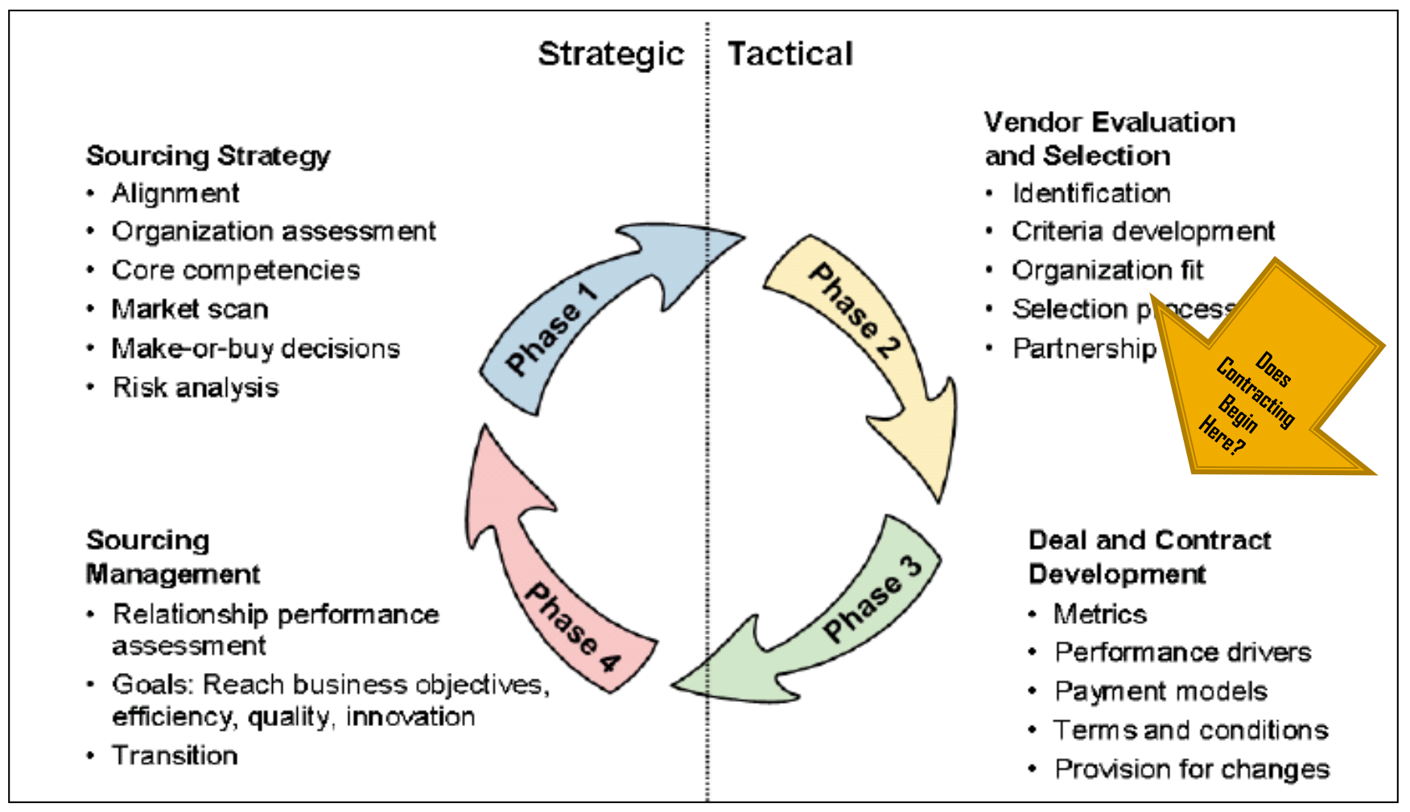
Services Sourcing Life Cycle

Slide 56
Recommendations 1
Better Vendor Sourcing Strategy
· An open tender would invite for more vendors and enhance competitiveness of the solutions instead of a limited tender. A stronger tendering process with proper pre-contract management would help client better estimate the project complexity and vendor selection.
· Setting pre-RFP stage before phase 1 (Sourcing strategy), pick the best ideas, and then place it into the pre-RFP. From there, selection of vendors would be more comprehensive and competitive.

Slide 57
Recommendations 2
Move into Full Agile; given the heavy user involvement
· An agile management could work better for our project, as it has obvious characteristics match agile management, such as common user involved, test products regularly, continuous improvement in the development of a product.
· Having minimum viable products could help management see the progress and allow greater customer collaboration over contract negotiation. The challenge would be customer availability. However, given that PA is a diverse organization with dedicated teams for product development, this could be worked out.

Slide 58
Conclusion
Knowing what Your Project Sponsor wants is most key. Project M had achieved success where its success factors were defined as balancing the triple constraint with Scope highest rated, as well as obtaining Stakeholder Buy-in, having Clear Project Objectives, and being led by an experienced Project Manager.
Project outcomes could be better improved with (1) better vendor selection and (2) an agile project management.

Slide 59
THANK YOU !!

